Slide 1
API and JSON
Daniel Ortiz

Slide 2
API
An Application Programming Interface (API) is a set of commands, functions, protocols, and objects that programmers can use to create software or interact with an external system.

Slide 3
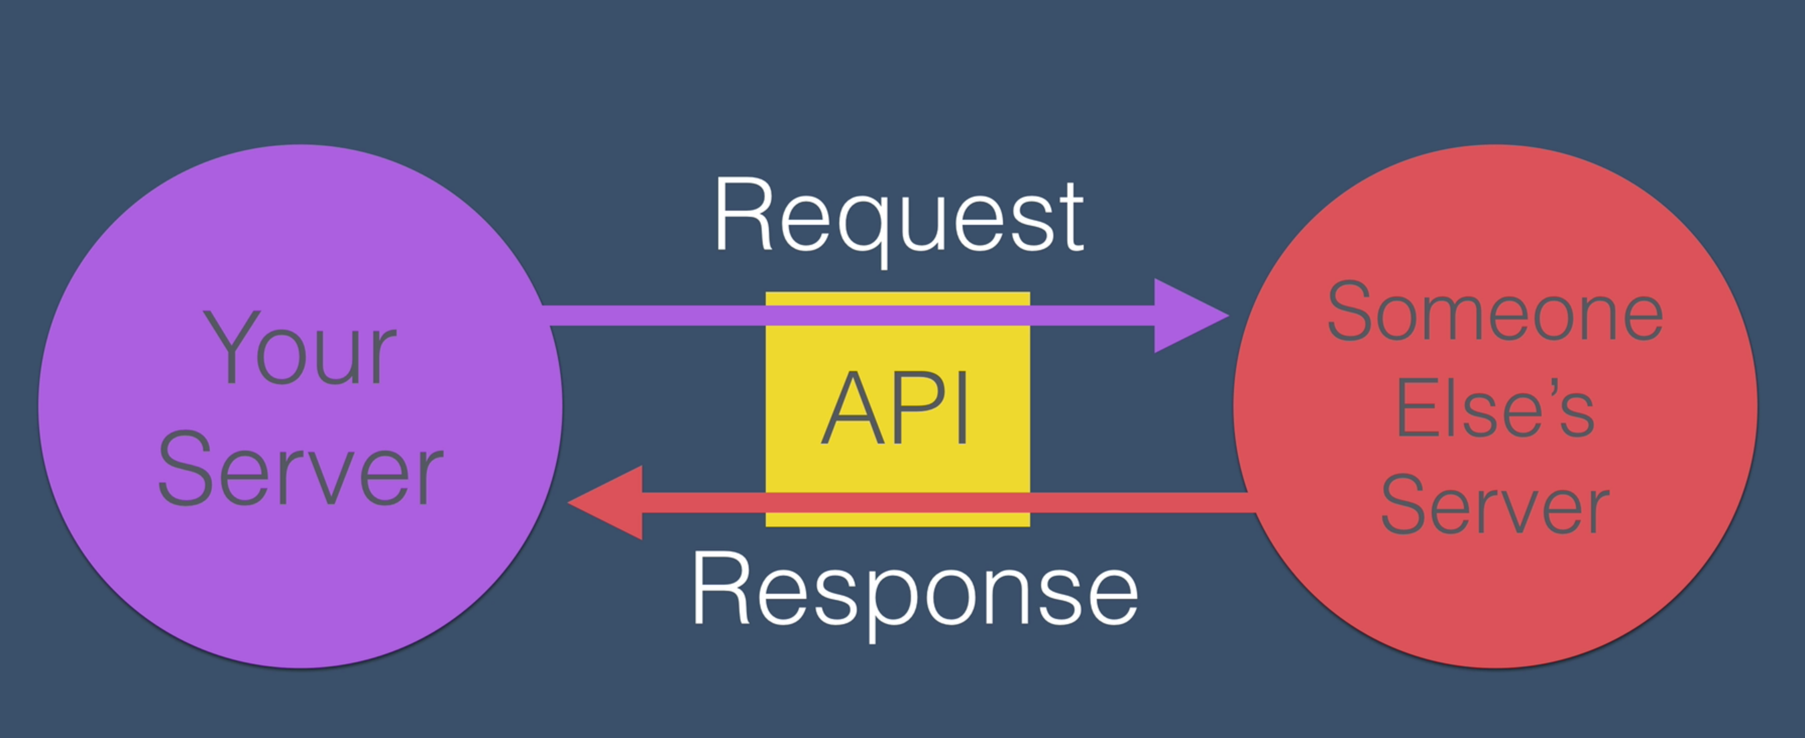

Slide 4
Characteristics
Endpoint
Paths
Parameters
Authentication

Slide 5

https://www.themoviedb.org

Slide 6
Endpoint
https://api.themoviedb.org/3/

Slide 7
Path
https://api.themoviedb.org/3/movie/
https://api.themoviedb.org/3/tv/

Slide 8
Parameters
https://api.themoviedb.org/3/movie/76341?api_key=03489168c91daedb4cf2392dc599b41e&language=de

Slide 9
Authentication
API key = 03489168c91daedb4cf2392dc599b41e
https://api.themoviedb.org/3/movie/76341?api_key=03489168c91daedb4cf2392dc599b41e

Slide 10
JSON
Javascript Object Notation

Slide 11
Your homework
Provide me with the ”Now playing” movies in Mexico with the language set to English.
This will involve reading JSON, but you can use a JSON parser and copy and paste the information into it and read more easily.
The URL should look like this: https://api.themoviedb.org/3/movie/<<Path>>?api_key=<<api_key>>&language=<<language>>&region=<<>>

